Slide 1
Master Data Discussion

Slide 2
Business Unit Definition
Their holistic job responsibilities support a specific Business Unit, or
They are a dedicated site support member where the site is specific to a given Business Unit (i.e., HR, IT, Facilities), and
They are not a part of a shared service which supports across multiple Business Units (i.e., HR Shared Services, IT Help Desk), which will be designated as Corporate

Slide 3
Master Data Definitions
Sites
(Work Location)
Roll Ups
Entity/
Company
Functional
Business
Unit
Payroll
Costs
Line of Business
Leader
Chewy Inc.
Chewy.com
All Chewy
Corporate
Chewy Pharmacy
Chewy Wholesale
Chewy Retail
Fulfillment Center
Customer Service
Chewy Inc.
Corporate
Card Writers
Customer Service
Fulfillment Center
Sumit S.
John G.
Mario M.
Satish M.
Etc.
All Site
Corporate
Customer Service
Fulfillment Center
Chewy Pharmacy
All Locations
FLL1
BOS1
FLL3
Etc.
All Chewy
Finance
HR
IT
Product
WD Hierarchy
Region Hierarchy
Business Function Hierarchy
Manager Hierarchy
Location Hierarchy
Foundational Data Element
Work Location
Work Location
Region
Cost Center
BU as CC Worktag
Oracle Dept + Loc/Company
Notes:
Problem statement and associated Goals
How does Finance get Oracle Location Codes to align to TMs?

Slide 4
BU Worktag Update Process
Potential to change up to 800 peoples cost mapping through remapping to different cost centers or adding new cost centers
Concern with testing now closed on the Payroll implementation
Recommendation to implement after Phase 2b goes live (target P8)

Slide 5
Master Data Definitions
In our business we need to aggregate employee data for various reasons:
Leader and Functional data (i.e., org effectiveness measures, attrition, etc.)
Company and Cost data (i.e., financial reporting, cost allocations, etc.)
To produce reliable, repeatable and sustainable reporting, we need to align on hierarchy definitions, such as:
Company - Entity Roll Up (based on Oracle Company/Region in Workday)
Accounting – Payroll Cost Roll Up for actuals loading to Oracle / Hyperion
Finance – Forecasting Cost Roll Up to compare actuals to forecast (based on Home Cost and Hyperion Department)
Leader – Roll Up by C-Suite Leader (based on Manager hierarchy)
Functional – Rollup by function and sub-function (i.e., HR as a L1 function, and Talent Acquisition, HR Business Partner, Total Rewards as L2
Business Unit – Rollup to Corp, CS and FC (based on where the role supports - i.e., CS HR vs FC HR vs Corp HR)
Location – Rollup by either Physical Site or Cost Location
Job Family – Rollup of various job family groups across functions - will define in the future with Total Rewards and Talent Acquisition.
Notes:
Problem statement and associated Goals
How does Finance get Oracle Location Codes to align to TMs?

Slide 6
Workday Source Data Model
Updated 4/13
Workday Base Data Elements
Cost Center Code (aligned to ADP Department) is a 4-digit number
Cost Center Name (description of the code)
Business Unit is a Worktag (attribute) attached to Cost Center
Hierarchies
Department Name (used by IT) is an attribute of the cost center to provide more details for passing downstream to IT systems (d-lists, AD, outlook accounts)
Accounting Hierarchy – every cost center rolls up to the Chewy Finance Cost Center Hierarchy > Oracle Department Subtype
Region Hierarchy – Oracle Company
Function is a parent hierarchy of the cost center (Chewy Cost Center Hierarchy > Business Function subtype)
Line of Business is a location hierarchy (parent to location)
Other Data
Worker Type (Employee vs Contingent Worker) – will determine what data will see completed on the worker record
Job profiles will determine the FLSA category

Slide 7
Workday Organization Data Elements
Updated 4/13
Workday has 2 hierarchies available based on cost center as foundational element
One is organized in Accounting costing model
This drives the JE’s for GL vs the roll up for Finance
The other is more of a functional
We can an additional BU tag on the cost center which rolls up to BU Hierarchy
Employee Handbook (need to be validated) – condition rule impacts
Birth right access (design needs to be reviewed) – integration impacts
OTPs and Comp Changes - approval workflows impacts

Slide 8
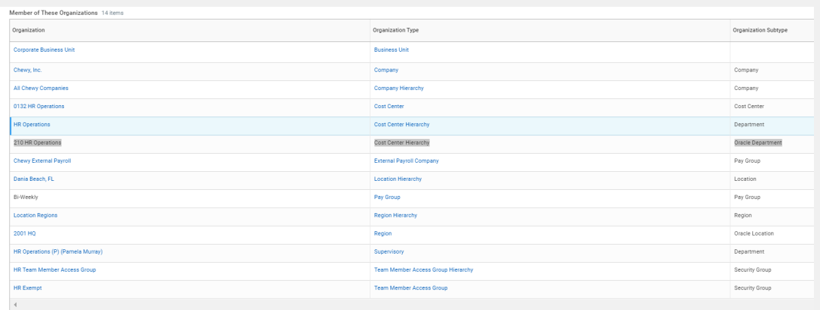
Workday Organization Data Elements

Slide 9
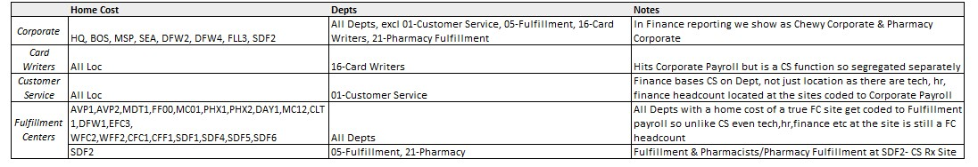
Finance Cost Hierarchy
Currently: Finance Business Unit Hierarchy
Do we have any other defined hierarchies in the company today?
Notes:
Goal: Acquire most accurate data definitions and calculations.

Slide 10
ADP Source Data Model
Updated 4/13
ADP
Home Department is a 6-digit number which contains three attributes: Location (2), ADP Department + FLSA {odd/even} (4) (Field Name: Home Department Code)
Home Department Description is varchar field representing the name of the home department code
GL Costing is a 10-digit number that has the Oracle costing location (4), ADP department (4), and Hyperion department (2) is still using this off the backend of payroll (Field Name: Home Cost Number Code)
(Reference from historical perspective)

Slide 11
Guidance – to be vetted with HRLT
For Talent Metrics, we will report these by Leader (i.e., C-suite) and/or function (i.e., HR, Finance, etc.) with drill downs available (see #2)
Leader – based on the manager reporting hierarchy, including a specific designation for the C-suite level (we can base this on position vs person to assist with the history concern)
Function – based on functions and their sub-functions – i.e., HR, IT, Facilities, Finance, Supply Chain.
2) Under Leader or Function we want to filter and sort by other hierarchies, such as:
Business Unit – What business unit do they work in/support – i.e., CS HR vs FC HR vs Corp HR
Note: SDF2 will continue to roll up to FC vs CS due to where it report into.
Finance – Where payroll costs are allocated
Manager Hierarchy – Additional drill downs for manager reporting hierarchy
Location – Where team members are located based on their work location
Company – Based on the accounting Company designation which allows us to get reporting by Chewy.com vs RX (based on Oracle company code)

Slide 12
MBR Page 0 Guidance
BIS reporting will align to the Finance roll up
This is reported via Workday, using Active/LOA team members for the period (includes Interns, Co-Ops, and Company Temps – but does not include contingent workers)
CS and FC support functions will roll up to CS and FC respectively (not Corp) – include a copy of the Finance report in the Appendix of the MBR
Roll up CS Card Writers to CS (footnote accordingly with method and count)
We will ask to include a copy of the Finance report in the MBR appendix so that we can tick and tie (leaving no questions remaining before it goes to the Enterprise MBR)
2) Hiring metrics for Corp, CS and FC will continue to use the currently defined hierarchies
Reported via Greenhouse, the TA teams use their own version of a Hierarchy (based on the assigned recruiter)
Per Adam, we have historically used it for our reporting (excel based) as a way to grab the roles our team responsible for since there are times we recruited (past tense) for roles in CS or FC.
For items like Fills, SLAs, Open Reqs etc. we will need to use the current roll ups by “hiring team responsible”
Eventually this data will need to be fed into a custom fields in Greenhouse so it is aligned with our other Talent Metrics
3) Attrition metrics for Corp, CS and FC will align to the BIS method of roll up (using Finance Hierarchy less Card writers)
We can include a new Corp appendix that shows the vol, invol and total attrition by function (i.e., for all of HR)
CS and FC will continue to be shown Exempt/Non Exempt by location

Slide 13
Hierarchy Discussion
In addition, we need to ensure definitions for these hierarchies and metric calculations are consistent across teams
Hierarchy definition examples:
Entity (Chewy.com, Chewy Pharmacy, Chewy Wholesale, Chewy Retail)
Business Unit (Corporate, Customer Service and Fulfillment Center)
Payroll Costs (Corporate, Card Writer, Customer Service and Fulfillment Center)
Field | Workday | Greenhouse | Hyperion | Kronos
Entity | Region Hierarchy (equals Oracle Company) 100 = Chewy.com 200 = Chewy Retail Pharmacy 600 = Petsmart Pharmacy | Does not exist in GH. | Is in Hyperion. | N/A
Location | Location is used for the work location (i.e., for payroll taxes) Ex. FLL1 | Is in Greenhouse but need to review as it may be multiple. | N/A | Is in Kronos – have more locations than in ADP (Labor Level 1).
Cost Location | Region* is used for costing in Workday vs home cost in ADP (Oracle Location includes allocation/consolidation using Finance rules) Ex. 2001 HQ * Designated by position, updated manually in a weekly audit on Friday’s for any changes/updates needed. | Does not exist in GH – confirm? Region on the requisition will be the primary work location. | Is in Hyperion. | Is in Kronos as an additional location.
Cost Center | Cost Center is aligned to functional dept in Workday Ex. 1300 (HR Fulfillment) | Does not exist in GH. | N/A | Is in Kronos (as Labor Level 2).
Cost Department | Finance Cost Center Hierarchy Ref ID (code that represents the Hyperion dept and is mapped 1:1 to Oracle dept) Ex. D29 D01 – D53 (based on budget owner) | Is in Greenhouse. | Is in Hyperion.
Notes:
Problem statement and associated Goals
How does Finance get Oracle Location Codes to align to TMs?

Slide 14
Definitions in the HR Data Dictionary
Field | Source | Definition | Calculation
Fills | Greenhouse | A requisition is denoted as filled if: (1) An offer is in an accepted status (sent, signed, and candidate is marked as hired) (2) the req opening has been filled by a hired candidate (this is automatic in GH). | Count based on filters*
Pending Starts | Greenhouse | Number of future employees which fulfill the above description as a “fill” but have not reached their 'Start Date’ in Greenhouse. This could include internal transfers and promotions, less in-role promotions which are performed as a part of the year end or mid – year talent cycle. | count[Start Date > Current Date]*
Time to Fill (TTF) | Greenhouse | Time calculation for how long it takes to 1) close a job (aka: resolved date of a requisition based on hire, rehire, internal transfer or promotion) for C02 and above roles. | Resolved Date (Offer) - Open Date (Job)*
Fill Rate (C01 roles) | Greenhouse | For C01 roles, this is the % complete of the labor order, calculated on the start date. This is a manual process to gather, aggregate and calculate this rate. | # Hires / Labor Order (Fill Rate for the Shift), and combined for weekly fill rate
Time to Start (TTS) | Greenhouse | The time between when a requisition is opened (open date) in Greenhouse to the team members start date within the offer grid (start date). | Start Date - Open Date (Job) in GH
All Open FTE Positions | Greenhouse | List of all FTE (not contingent worker based on corp business, corp tech, corp product and CS experience) openings with average days open and count of openings shown. | Count countd([Opening ID]) Days Open TODAY()-[opening_opened_date]*
Hires | Workday | Team members who have started an employment relationship with Chewy (i.e., shown up, hours worked, must be paid) designated by a “Hire” Record in Workday | Count based on filters*
Fiscal Year (FY) Starting Headcount | Workday | Count of non-terminated employees at the start of the fiscal year, includes Active and LOA team members. | Count based on filters*
Current Headcount | Workday | Count of current active/LOA employees at any given point in time, includes Active and LOA team members. | Count based on filters*
Attrition Rate | Workday | Percentage of employees (active and LOA TMs) that leave the organization within the fiscal period (based on the fiscal calendar). | [(Terminated Employees/Current Active AND LOA Headcount)]*100
Hyperion Approved Headcount | Hyperion | Financially approved positions (new, incrementally approved, forecasted headcount) which are available for recruitment. | Count based on filters*
Hyperion Forecasted Target Headcount | Hyperion | Target headcount based on approved hiring plan by period (does not factor in attrition) | Count based on filters*
Total FY Start (Hires) | Workday | Count of Hires in Current Fiscal Year/Quarter/Month/Week | Count based on filters*
*Standard filters will exclude Interns/Co-ops/temporary employees/contractors. Includes FT and PT employees. Does not include 1099 Vet Techs.
Notes:
Goal: Acquire most accurate data definitions and calculations.

Slide 15
Corporate
Data Definitions and Metric Calculations for Corporate Hiring and Attrition
Metric | Source | Definition | Calculation | Goal
Actual BIS (embed +/- % to goal via color) | Workday | Number of Active and LOA team members per period; does not include interns/Co-ops or temporary employees (due to attrition calculation impacts) | Workday HC reports based on appropriate filters
# Starts (new hires) | Greenhouse | Number of newly hired team members during the period. | # of Accepted Candidates based on Start Date
Avg Time to Start (days) | Greenhouse | The time (in days) it takes for a role to start (based on the Greenhouse Start Date). | Start Date - Open Date (Req)
% Fill within SLA | Greenhouse | Percentage of requisitions filled (or closed via hire, rehire, internal transfer, promotion) within the designated time frame.
# Director+ Starts | Greenhouse | Number of newly hired team members at the Director level and above during the period.
Director+ Open Reqs | Greenhouse | Number of open requisitions targets for Director and above.
% Director + Fill within 120 day SLA | Greenhouse | Percentage of Director and above roles that are filled within the designated SLA time.
Period Attrition % | Workday | Percentage of leavers in the period based on the average headcount between the previous and current period. | [# Terms]/[(Previous period beginning HC + Previous period ending headcount )/2]
Period Attrition % w/in Year 1 | Workday | Percentage of Leavers who left the organization during the period before hitting 1-year of service. | [# Terms]/[(Previous period beginning HC + Previous period ending headcount )/2]
# High Performer Leavers (FY2020 mid-year data) | Workday | Number of Leavers in the period who were marked as High Performers (Talent Review 1,2 & 4 boxes) based on the most recent talent review cycle.
Contingent Workers (footnote 1099s) | Workday + Kronos | Need to define for the future.
Notes:
Goal: Acquire most accurate data definitions and calculations.

Slide 16
Customer Service
Data Definitions and Calculations for Customer Service Hiring and Attrition
Metric | Source | Definition | Calculation | Goal
Actual BIS | Kronos via Vertica
# Starts | Greenhouse | Need to confirm Starts metric vs Fills metric
Avg Time to Fill (days) | Greenhouse Brack – NE Nicole – Ex (manual)
% Fill Rate (based off weekly labor request) | Greenhouse Brack – NE Nicole – Ex (manual)
% Graduation Rate
Attrition % (embed +/- target via color) |  | Attrition is only if they started, otherwise there are no shows.
Total Hires
% Fill within SLA
Notes:
Goal: Acquire most accurate data definitions and calculations.

Slide 17
Fulfillment Center
Data Definitions and Calculations for Fulfillment Center Hiring and Attrition
Metric | Source | Definition | Calculation | Goal
Actual BIS
# Starts
% Fill Rate
Avg Time to Fill (days)
Attrition % (embed +/- target via color)
% on LOA% (embed +/- target via color)
# Return to Work Outstanding
# Engagements completed
% Filled within SLA
Director + Open Reqs
% Director + Fill within 120 day SLA
Notes:
Goal: Acquire most accurate data definitions and calculations.

Slide 18
Talent Acquisition Insights

Slide 19
Talent Acquisition Quad Chart
[Answer]
[Answer]
What Source System does your data come from?
Are there any unique calculations that are specific to TA?
[Answer]
[Answer]
Are there any other reports that are impacted by these metrics?
Who is responsible for data collection? (Owner)
Notes:
Goal: Have a working chart for each group to understand how they are aggregating data and who owns that process for each BU.

Slide 20
Human Resources Insights

Slide 21
Human Resources Quad Chart
[Answer]
Are there any unique calculations that are specific to HR?
[Answer]
What Source System does your data come from?
[Answer]
[Answer]
Are there any other reports that are impacted by these metrics?
Who is responsible for data collection? (Owner)
Notes:
Goal: Have a working chart for each group to understand how they are aggregating data and who owns that process for each BU.

Slide 22
Update Cycle for Data

Slide 23
Important Considerations
Based on the last day of the period (Sunday), how long does it take for data metrics to be confirmed as final?
What are the short- and long-term solutions for sourcing this data?
Notes:
Goal: Source each teams working schedule around compiling and delivering data AND what system they are using as their source of truth.
Ideal State: All source systems are uniform across Business Units.

Slide 24
Logistics for Data Delivery

Slide 25
Data Delivery Schedule
Period | Period Start Date | Period End Date | Due Date for Analysis (T-Minus 8 Days) | Due Date to HRLT for Review (T-Minus 6 Days) | Earliest MBR Meeting Date
P01 | 2/1/2021 | 2/28/2021 | 3/1/2021 | 3/3/2021 | 3/9/2021
P02 | 3/1/2021 | 4/4/2021 | 4/5/2021 | 4/7/2021 | 4/13/2021
P03 | 4/5/2021 | 5/2/2021 | 5/3/2021 | 5/5/2021 | 5/11/2021
P04 | 5/3/2021 | 5/30/2021 | 5/31/2021 | 6/2/2021 | 6/8/2021
P05 | 5/31/2021 | 7/4/2021 | 7/5/2021 | 7/7/2021 | 7/13/2021
P06 | 7/5/2021 | 8/1/2021 | 8/2/2021 | 8/4/2021 | 8/10/2021
P07 | 8/2/2021 | 8/29/2021 | 8/30/2021 | 9/1/2021 | 9/7/2021
P08 | 8/30/2021 | 10/3/2021 | 10/4/2021 | 10/6/2021 | 10/12/2021
P09 | 10/4/2021 | 10/31/2021 | 11/1/2021 | 11/3/2021 | 11/9/2021
P10 | 11/1/2021 | 11/28/2021 | 11/29/2021 | 12/1/2021 | 12/7/2021
P11 | 11/29/2021 | 1/2/2022 | 1/3/2022 | 1/5/2022 | 1/11/2022
P12 | 1/3/2022 | 1/30/2022 | 1/31/2022 | 2/2/2022 | 2/8/2022
Notes:
Goal: Determine if each team can meet the Analysis Due Date based on the data aggregation needed per team

Slide 26
Additional Questions?

Slide 27
Thank You!
HR Operations

Slide 28
Appendix

Slide 29

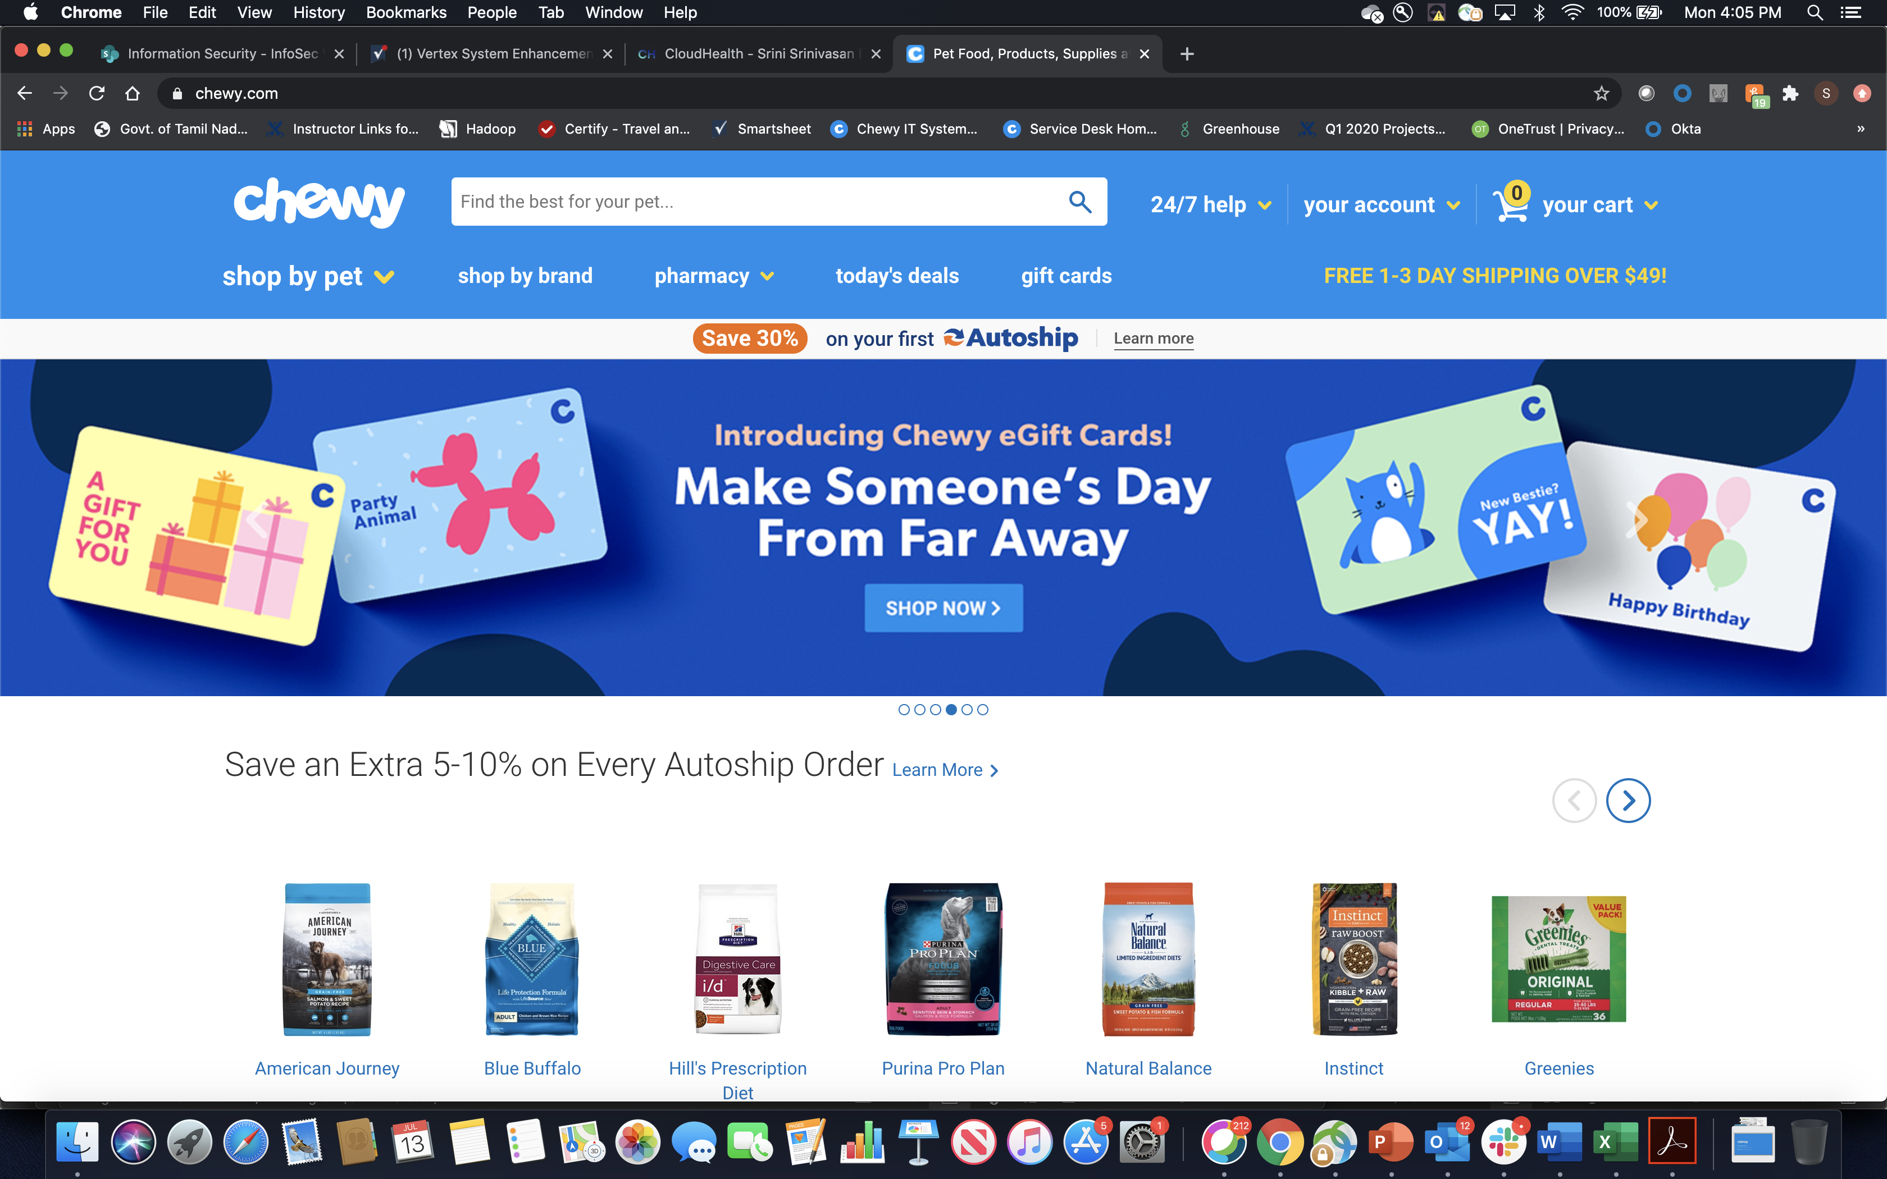
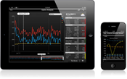
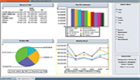
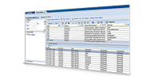
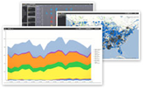

HR Data & Analytics Platform – Conceptual Diagram
GreenHouse
Adobe
WorkDay
Gallup
Users, Systems, Partners
Data Platform in Cloud (AWS)
Feeds & Extracts
Transactional Systems
AmTrav
Kronos
ADP
Certify
Mobile
Analytics
LMS
Mart Layer
Integrated Layer
Operational Layer
Aetna
Fidelity
Dashboards, cubes
Unum
PayFlex
Benefits Data
Team Member Lifecycle
Exp Mgmt
Discovery
Business Value
Cigna
Enterprise Reporting
Hierarchy
Social Media
E-Verify
Navex
Additional Sources
Market Data
DocuSign
Advanced Analytics
Business Metrics
Fastenal
Data Mining / Data Science
Data Quality
Master Data Management & Data Governance

